Slide 1


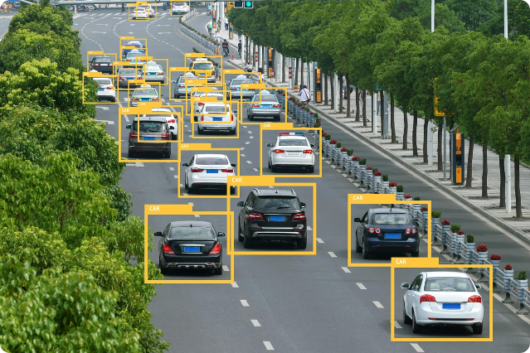
VEHICLE CUT IN DETECTION

Slide 2
Sensor Fusion Approach
Multiple Sensors
Redundancy
Complementary Data
Combining data from cameras, radar, and lidar to build a comprehensive understanding of the vehicle's surroundings.
Leveraging multiple sensors provides redundancy, improving reliability and fault tolerance.
Each sensor type offers unique strengths, with the sensor fusion algorithm intelligently integrating the data.

Slide 3

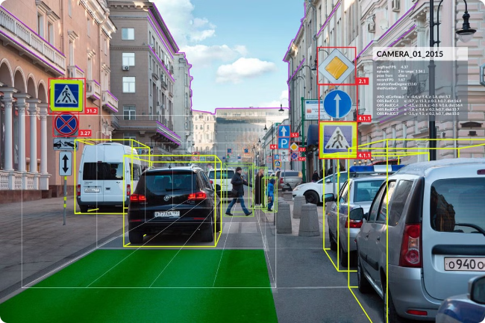
Computer Vision Techniques
1
Object Detection
Identifying and classifying objects, such as other vehicles, pedestrians, and obstacles.
2
Lane Detection
Tracking lane markings to determine the vehicle's position within the lane.
3
Trajectory Prediction
Anticipating the future movements of surrounding vehicles and vulnerable road users.
4
Occlusion Handling
Accounting for obstructions that temporarily block the vehicle's view of its surroundings.

Slide 4
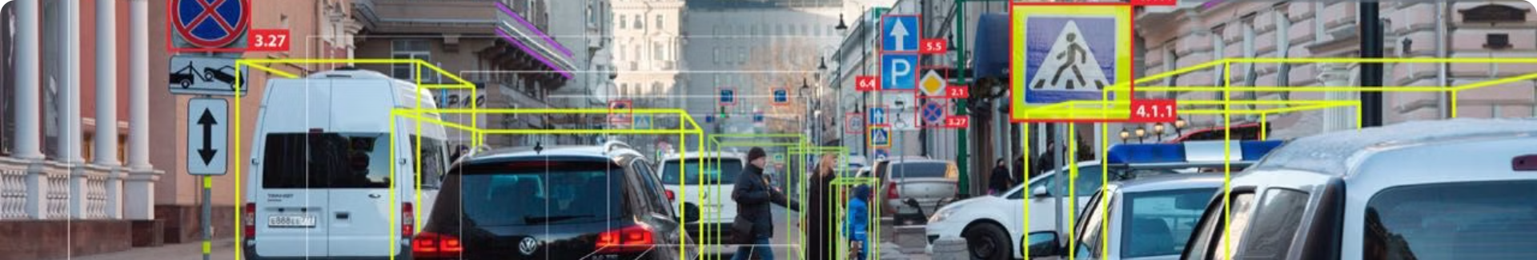
Cutting-Edge Algorithms
Deep Learning
Sensor Fusion Algorithms
Leveraging advanced neural networks for robust object detection, classification, and scene understanding.
Sophisticated data fusion techniques that seamlessly integrate multi-sensor data to improve accuracy and reliability.
Probabilistic Modeling
Incremental Learning
Applying probabilistic reasoning to handle uncertainty and make informed decisions in complex driving scenarios.
Continuously updating and refining the system's understanding through real-world experience and feedback.

Slide 5


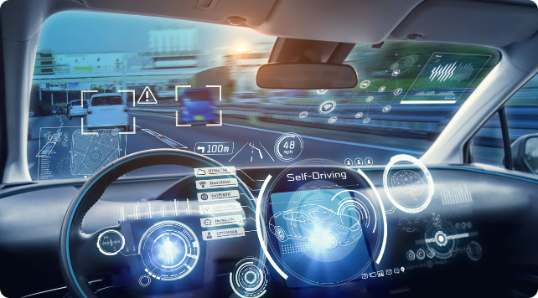


Robust Performance
Reliable Perception
Accurate detection and classification of road users and obstacles, even in challenging conditions.
Predictive Reasoning
Anticipating the behavior of surrounding vehicles and vulnerable road users to enable proactive decision-making.
Smooth Driving
Seamless integration of the vehicle's control systems for comfortable and safe maneuvers.

Slide 6


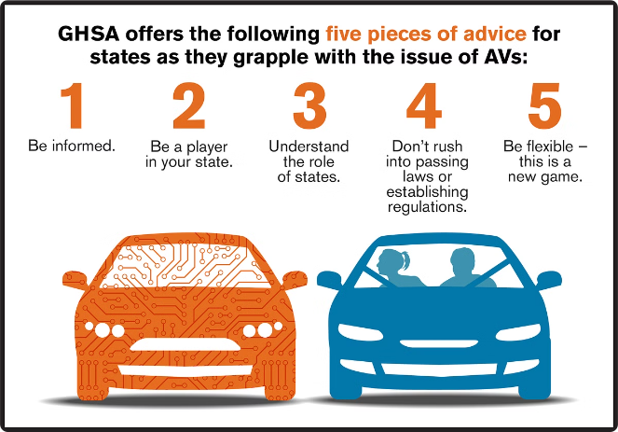



Safety Benefits
Accident Prevention
Significantly reducing the risk of collisions by detecting and responding to potential hazards.
Injury Mitigation
Minimizing the severity of collisions through advanced safety features and smart vehicle control.
Improved Mobility
Enabling safer navigation for all road users, including vulnerable groups like the elderly and disabled.
Environmental Impact
Contribution to reduced emissions and energy consumption through more efficient driving.

Slide 7

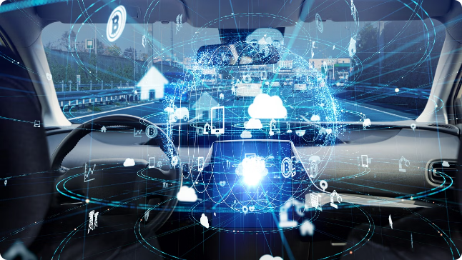
Technological Advancements
1
Sensor Innovations
Continuous improvements in camera, radar, and lidar technologies for enhanced perception.
2
Computing Power
Rapid growth in processing capabilities enabling real-time decision-making and control.
3
AI Breakthroughs
Advancements in machine learning and artificial intelligence for robust scene understanding.

Slide 8

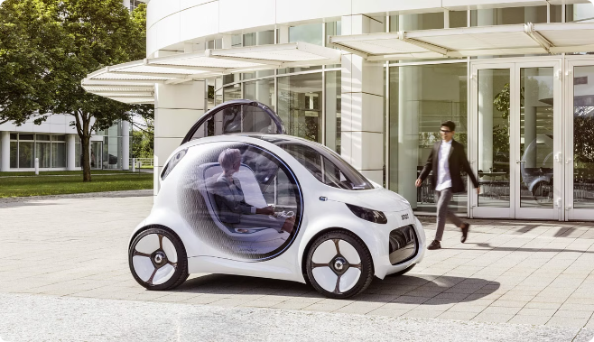
The Future of Vehicle Cut Detection
Seamless Integration
Fully autonomous vehicles that can handle complex traffic scenarios with ease.
Ethical Considerations
Addressing privacy, liability, and societal impacts of advanced vehicle technologies.
Regulatory Frameworks
Developing appropriate policies and standards to ensure safe and responsible deployment.
Global Collaboration
Worldwide cooperation to accelerate innovation and create a safer, more connected transportation ecosystem.

